Slide 1
Demand For Higher Education Programs
Results through January 2019

Slide 2
Who is Gray?
Clients: Higher Education Institutions and Stakeholders
Program and Market
Evaluation Data
Student Demand
Employment
Competition
Wages
Demographics
Placement Rates
Employer Requirements
Advanced Analytics
Predictive Models
Geo-Analytics
Programs
Place
Price
Projects
Program Evaluation System
Program Economics Platform
Integrated Program Analysis
Market Analysis Platform
Location selection
Campus consolidation
Price elasticity
Price positioning
Price optimization
Business strategy
Strategy implementation
Complex analytics

Slide 3
Inquiries
National
Online and On-Campus
Program, Degree, and City
Google Search Trends
Programs
Brands
Growth and Decline
Brand Reach
Program of the Month: Health Services/Allied Health, General
Where to Offer a Program: Market Analysis
Summary

Slide 4
Overall Student Inquiries (All Sources)
Gray has tracked demand for several years.
We started tracking inquiries in 2012 and Google search volumes in September 2016.
In our webinars, we share data for the last three years.
Source: GrayReports – Inquiry Trends, Gray’s Program Evaluation System

Slide 5
Student Inquiries (All Sources)
For the second consecutive year, inquiries in January have increased year-over-year.
We recorded more inquiries in January than in any other month since August 2016.
+ 4%
YoY
Source: GrayReports – Inquiry Trends, Gray’s Program Evaluation System

Slide 6
Student Inquiry Conversions (All Sources)
In the last “mature month,” October 2018, conversions increased 7% year-over-year.
Conversions of November and December 2018 inquiries, while incomplete, have already exceeded prior-year counts.
+ 7%
YoY
Immature¹
Immature Months¹
Conversions are counted in the month in which the inquiry is received (i.e., an inquiry that is received in January and converts in March will be counted as a January inquiry). Typically, the application rate will rise for at least three months after the month in which the inquiries are received.
Source: GrayReports – Inquiry Trends, Gray’s Program Evaluation System

Slide 7
Average Price for Pay-per-Inquiry
Price-per-inquiry has continued its pattern of year-over-year increases.
Price-per-inquiry was $0.02 higher in January than December.
+ 1%
YoY
Note: PPI means “Pay per Inquiry.” Inquiry price is the average price per inquiry from PPI.
Source: GrayReports – Inquiry Trends, Gray’s Program Evaluation System

Slide 8
Inquiries
National
Online and On-Campus
Program, Degree, and City
Google Search Trends
Programs
Brands
Growth and Decline
Brand Reach
Program of the Month: Health Services/Allied Health, General
Where to Offer a Program: Market Analysis
Summary

Slide 9
Inquiries for Online Programs
Inquiries for online programs increased 3% in January.
Inquiries for online programs have increased year-over-year in each of the past 10 months.
+3%
YoY
Source: GrayReports – Inquiry Trends, Gray’s Program Evaluation System

Slide 10
Inquiries for On-Campus Programs
Inquiries for on-campus programs in January declined by 18%, a dramatic drop.
This continues a long pattern of year-over-year decreases in inquiries for on-campus programs, with drops for 22 of the past 24 months.
-18%
YoY
Source: GrayReports – Inquiry Trends, Gray’s Program Evaluation System

Slide 11
Inquiries for Programs with Unknown Modality
Inquiries for programs with unknown modality jumped 32% in January.
January marked the highest inquiry volume for programs with unknown modality in more than three years.
+32%
YoY
Source: GrayReports – Inquiry Trends, Gray’s Program Evaluation System

Slide 12
Inquiries
National
Online and On-Campus
Program, Degree, and City
Google Search Trends
Programs
Brands
Growth and Decline
Brand Reach
Program of the Month: Health Services/Allied Health, General
Where to Offer a Program: Market Analysis
Summary

Slide 13
The Big 5 Programs
Criminal Justice program inquiries increased 53% year-over-year in January.
For four months, Medical Assistant inquiries have declined almost 20% year-over-year.
Source: GrayReports – Inquiry Trends, Gray’s Program Evaluation System

Slide 14
The Fast 5 Programs¹
Two health-related programs grew by 100% or more year-over-year in January.
Health Services/Allied Health, General has been in the “Fast 5” programs five months in a row.
This is the second month that Mental Health Counseling grew more than 140% year-over-year.
Two computer-related disciplines grew by over 50% in January.
Selected from the 75 programs with the highest inquiry volume since January 2012.
Source: GrayReports – Inquiry Trends, Gray’s Program Evaluation System

Slide 15
The Big 5 Cities
In January, all Big 5 Cities reversed their 2018 trend.
In January, inquiries in Chicago increased 13%.
Philadelphia inquiries continue to decline.
Note: The market for each city is defined as a 15-mile radius around the population center of its CBSA.
Source: GrayReports – Inquiry Trends, Gray’s Program Evaluation System

Slide 16
Inquiry Volumes by Degree Level
Inquiries rose year-over-year at all degree levels except Undergraduate Certificates.
Source: GrayReports – Inquiry Trends, Gray’s Program Evaluation System

Slide 17
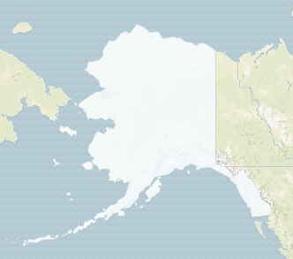
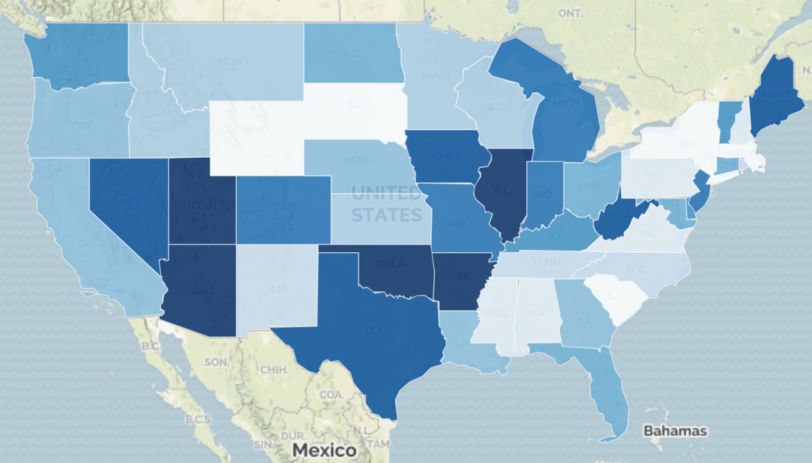
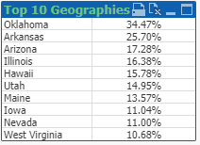
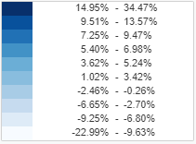
Inquiries: Year-over-Year Inquiries by State
The adjacent states of Oklahoma and Arkansas had the fastest inquiry growth.
The adjoining pair of Utah and Arizona also stands out for fast inquiry growth.
Source: GrayReports – Inquiry Trends, Gray’s Program Evaluation System

Slide 18
Inquiries
National
Online and On-Campus
Program, Degree, and City
Google Search Trends
Programs
Brands
Growth and Decline
Brand Reach
Program of the Month: Health Services/Allied Health, General
Where to Offer a Program: Market Analysis
Summary

Slide 19
Google Search Trends: Programs
Gray’s Google search index rose for the seventh month in a row, up 8% in January.
Gray tracks search volume for the 200 largest higher education programs.
In 2016, these programs produced 67% of all completions.
We track approximately 25 keywords for each program.
+8%
YoY
*Google Searches for 25 keywords for each of the 200 largest programs based on IPEDS completions

Slide 20
Google Search Trends: Shrinking Programs
Several STEM programs are among the fastest-declining in search volume.
Source: Gray Associates Research, Keyword Search Trends for Largest 200 IPEDS Programs.

Slide 21
Google Search Trends: Brands
January brand searches have been remarkably stable for the past three years.
Gray tracks search volumes for a sample of 75 higher education brands.
+0.2%
YoY
Source: Gray Associates research, keyword search trends for 75 college and university brands.

Slide 22
Fastest-Growing Brands
In Gray’s sample, the search volume for nine brands grew 10% or more in January.
This list includes state flagship campuses, as well as other publics, privates, and for-profits.
Source: Gray Associates Research, Keyword Search Trends for 75 Brands. Minimum 10,000 Google searches

Slide 23
Inquiries
National
Online and On-Campus
Program, Degree, and City
Google Search Trends
Programs
Brands
Growth and Decline
Brand Reach
Program of the Month: Health Services/Allied Health, General
Where to Offer a Program: Market Analysis
Summary

Slide 24
Program Sustainability: An Integrated View
We envision four foundations of program sustainability.
People
Markets for Programs
Money Program Economics
Process

Slide 25
Integrated Program Assessment
 | Integrated Program Report Card
 | Overall Evaluation (Grow, Fix, Sustain, Concern): |  | Fix and Grow
 | Mission and Overview: Faculty Comments |  |  |  |  | Economics: Institution Contribution Margin Analysis
 | Strong fit with focus on technology, global reach, and undergraduate education and employment. Need to bring the program up to the academic standards for the School of Computer Science; however, hiring doctoral faculty with knowledge of current issues is a challenge, since the state of the art is being developed in real-world situations addressing an ever-changing array of threats. |  |  |  |  |  | 2017 | 2018
 |  |  |  |  |  |  | Actual | Budget | Actual | Variance (Units) | Variance (%)
 |  |  |  |  |  | Starts | 200 | 210 | 220 | 10 | 4.8%
 |  |  |  |  |  | Enrollment | 1,200 | 1,210 | 1,220 | 10 | 0.8%
 |  |  |  |  |  | Student Credit Hours | 10,800 | 10,890 | 10,980 | 90 | 0.8%
 |  |  |  |  |  | Revenue $ | $3,240,000 | $3,267,000 | $3,294,000 | 27,000 | 0.8%
 |  |  |  |  |  | Instructional Costs $ | $972,000 | $980,100 | $980,100 | - | 0.0%
 |  |  |  |  |  | Contribution $ | $2,268,000 | $2,286,900 | $2,313,900 | 27,000 | 1.2%
 |  |  |  |  |  | Return on Instructional Cost (ROIC) | 2.33 | 2.33 | 2.36 | 0.03 | 1.2%
 |  |  |  |  |  | ROIC Percentile | 90% | 90% | 92% | 2% | 2.2%
 | Academic Standards: Internal Data |  |  |  |  | Market Attractiveness: Gray Associates
 |  | 2016 | 2017 | Variance % |  |  | 2017 Percentile | 2018 Percentile | Variance (Units) | Variance (%)
 | Faculty Accomplishments (e.g., publications) | Behind | On track | None |  | Student Demand | 90% | 91% | 1% | 1.1%
 | Student Ratings (top 2 box) | 90% | 85% | -5% |  | Employment | 85% | 89% | 4% | 4.7%
 | Outcomes: |  |  |  |  | Competitive Intensity | 35% | 33% | -2% | -5.7%
 | First Year Retention Rate | 70% | 71% | 1% |  | Degree Fit | 90% | 90% | 0% | 0.0%
 | 6-Year Graduation Rate | 50% | 55% | 5% |  | Overall Market Score | 95% | 95% | 0% | 0.0%
 | Employment Rate | 90% | 95% | 5% |  | Market Share | 3% | 2.50% | -1% | -16.7%
 | Continuous Improvement: Goals and Status 1. Achieve National Ranking: On track, curriculum upgraded. 2. Upgrade and Differentiate Tech Infrastructure: Simulated network, data center, and application environment in development. 3. Expand Recruiting to 30 High schools: Professors have visited 20 high schools in last 6 months.
 | 1

Slide 26
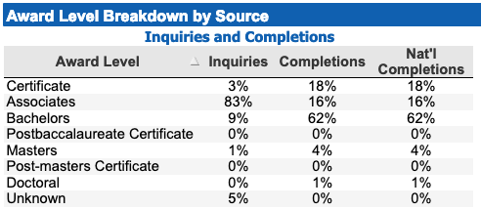
Program of the Month: Degree Fit
What is the most appropriate level for a “Health Services/Allied Health, General” program?
Bachelor’s-level program for students continuing to graduate school?
Bachelor’s-level “parachute” healthcare program?
Associate’s-degree program for transfer?
Certificate or Associate’s-degree entry-level program?

Slide 27
Program of the Month: Scoring
We suggest using four categories of market data.
Student
Demand
Employment
Degree
Fit
Competitive
Intensity

Slide 28
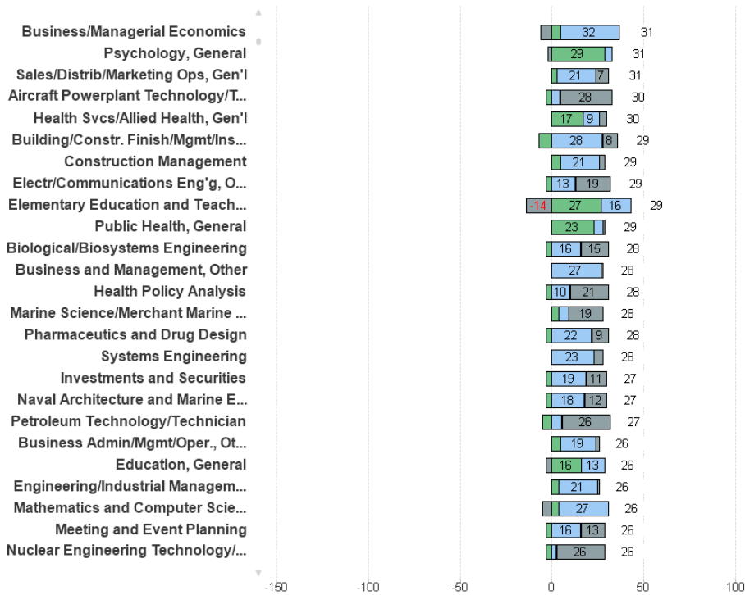
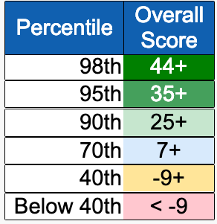
Program of the Month: Program Rank
Scoring on metrics in the four categories identifies potentially attractive programs.
National Program Scores and Ranking: Bachelor’s Programs (Max = 69)
Score

Slide 29
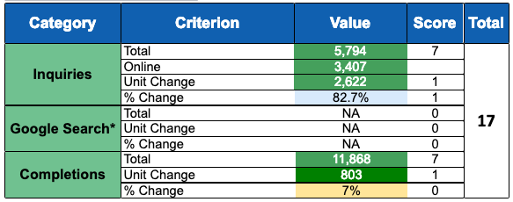
Program of the Month: Student Demand
Student demand indicators are positive for Health Services/Allied Health, General.
Lots of green
All inquiry metrics above 95th percentile
No Google Search data yet (program not in the top 200)
Completions also above the 95th percentile with decent growth

Slide 30
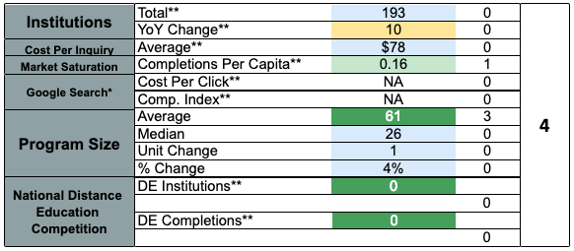
Program of the Month: Competition
Competition indicators are moderate for Health Services.
Limited number of competitors for a high-demand program, but more schools entering
Big average cohort size
No online competition (yet)

Slide 31
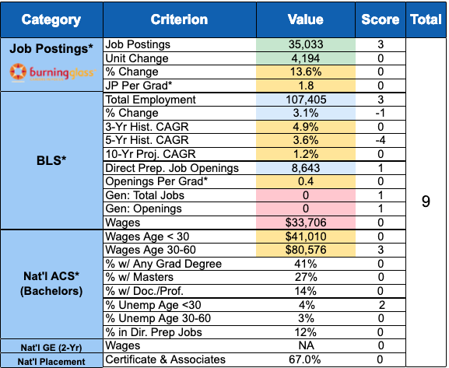
Program of the Month: Employment and Career Paths – Part 1
Only 12% of Bachelor’s-degree graduates go into direct prep jobs.
This is often a path to grad school – though more often Master’s than Doctoral.
Only 12% of employed graduates followed a path into a direct-preparation job.
Career outcomes are fine: average wages, low unemployment.

Slide 32
Program of the Month: Employment and Career Paths – Part 2
Direct-prep jobs for Bachelor’s graduates in Health Services are less appealing.
Entry-level wages are low.
There are a fair number of job postings and jobs.
Employment growth has been moderate.

Slide 33
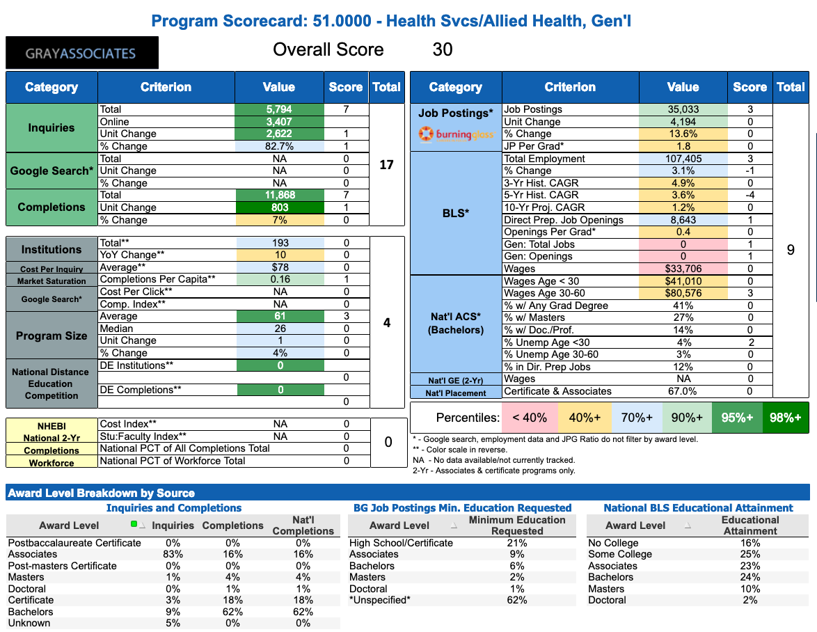
Program of the Month: Program Scorecard

Slide 34
Inquiries
National
Online and On-Campus
Program, Degree, and City
Google Search Trends
Programs
Brands
Growth and Decline
Brand Reach
Program of the Month: Health Services/Allied Health, General
Where to Offer a Program: Market Analysis
Summary

Slide 35
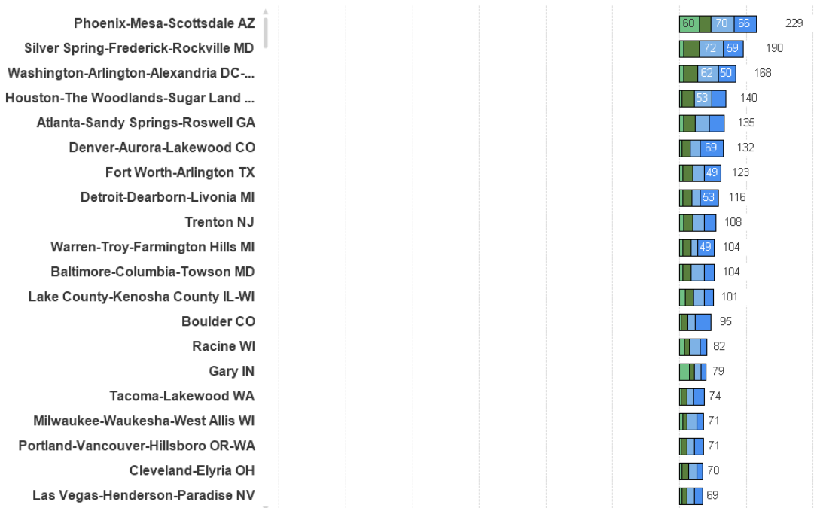
Offering a Bachelor’s Program in Health Services/Allied Health, General
Gray’s Market Analysis Program (MAP) ranks markets on estimated unfilled student demand for one or more programs.
For this program, Phoenix (AZ) has the most estimated market potential.

Slide 36
Ranking Markets Using Estimated Unfilled Demand
We calculate five independent estimates of student demand …

Slide 37
Ranking Markets Using Estimated Unfilled Demand
We then subtract actual completions by U.S. students from potential completions …

Slide 38
Ranking Markets Using Estimated Unfilled Demand
And the result is estimated unfilled demand, measured in annual completions…

Slide 39
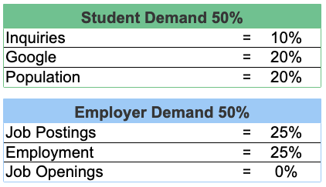
Ranking Markets Using Estimated Unfilled Demand
... Which we weight, based on institution priorities and program characteristics.

Slide 40
Inquiries
National
Online and On-Campus
Program, Degree, and City
Google Search Trends
Programs
Brands
Growth and Decline
Brand Reach
Program of the Month: Health Services/Allied Health, General
Where to Offer a Program: Market Analysis
Summary

Slide 41
Key Demand Trends and Observations
Total student inquiries were up 4% year-over-year.
Inquiries for online programs continue to rise.
Inquiries for on-campus programs continue to fall.
Inquiry conversion rates appear to be up each month for the entire fourth quarter 2018.
Inquiries for Criminal Justice programs rose 53% in January, while Medical Assisting inquiries continued their trend of 20% year-over-year declines.
Inquiries for Mental Health Counseling and Health Services/Allied Health, General continue their trends of very large year-over-year increases.
The adjacent states of Oklahoma and Arkansas saw the highest inquiry growth rates.
Inquiries at most levels continue to grow, while those for Undergraduate Certificates continue to decrease.
Among university brands, University of Texas at Austin showed the fastest growth in Google searches in January.
As always, good market data enables better program decisions.

Slide 42
Program Portfolio Optimization
How can your college or university make better program decisions?
Understand Student Demand Learn how to gather and evaluate data on potential students’ interest in academic programs.
Determine Employer Needs Learn data sources and techniques you can use to determine the skills graduates will need and the jobs and wages they may get.
Evaluate Competitive Intensity Learn how to assess the number, size, and power of your program’s competitors.
Calculate Program Economics Learn how to assemble and analyze data on course and program cost, revenue, margin, and overhead.
Inform and Engage Learn who needs to be involved and how to engage Constituencies them in a process that leads to better program decisions and strengthens ties among faculty and administrators.
Integrate and Sustain Learn how to integrate academic, financial, and market data in an ongoing program review process.

Slide 43
Webinar Schedule
Gray will offer education on program decision-making over the next six months.
Topic | Webinar Schedule (Eastern Time)
Determine Employer Needs | March 7, 2:00 PM
Monthly Trends in Demand for Higher Education Guest Speaker: BKD | March 21, 1:00 PM
Evaluate Competitive Intensity | April 11, 2:00 PM
Calculate Program Economics | May 16, 2:00 PM
Inform and Engage Constituencies | June 13, 2:00 PM
Integrate and Sustain | July 18, 2:00 PM

Slide 44
Demand for Higher Education Programs
Next Webcast: March 21st (February Results) 1:00 PM Eastern Time
Featuring a Guest Speaker from BKD!

